Slide 1
Factoring Marginalized Languages in the Botswana Curriculum: Reflections on prospects for the Khoesan
Kems Monaka
University of Botswana
18th July 2022. Riezlern, Austria
Notes:
The talk is motivated in part by the need for continued correcting a perception that existed for a long time that Botswana is the land of Batswana people who all speak Setswana language.
The perception could have been caused and perpetuated by the fact that at independence Setswana was the only indigenous language chosen as the national language and became the only one used in government, in schools, by the media and as the most used lingua franca.
The reality however, is that there are other indigenous languages in the country. And because of the position adopted by the new administration at independence in 1966, the languages became marginalized. And half a century later, the situation has not changed.
The talk is motivated in part by the need for continued pressure on the government of Botswana on reconsider its position on marginalised languages.

Slide 2
Background: New Developments in Botswana
Pursuant of determined decision to address learner problems at formative years of schooling, the Government of the Republic of Botswana has embraced recommendations made by Millennium Development Goals, UNICEF, National Development Plans, Revised National Policy in Education 1994 (recommendation 1), Vision 2016, Vision 2036, ETSSP (2015-2020).

Slide 3
Background: New Developments in Botswana
To that end, Government tasked the then Ministry of Basic Education (MoBE)to prepare a draft policy on Botswana Languages-in-Education, which the Ministry did in consultation with language experts.
Government further requested for comprehensive, nationwide consultation with the peoples of the Republic.

Slide 4
Background: New Developments in Botswana
After further approval and finalization of the draft by Cabinet and legislation by Parliament, the Languages-in-Education policy would then be a blueprint on modalities of implementation in schools and other related issues.

Slide 5
Background: New Developments in Botswana
The policy would introduce local languages as medium of instruction from Reception to Standard 2, and the criterion of most known language in a locality will be used in the local school.
The proposition is that mother-tongue teachers would be workshopped to teach the languages.

Slide 6
Background: New Developments in Botswana
There will be mother-tongue instruction that will be accompanied with explanation in Setswana to transition learners to the National language which will be the sole medium of instruction at Standard 3.
The Department of Curriculum Development and Evaluation (DCDE) has been seized with the development of literacy materials for this initiative (State of the Nation Address 2022)

Slide 7
Background: New Developments in Botswana
Setswana would be introduced at Standard 1 as is current practice and used as the sole medium of instruction in Standard 3.
English would be used as sole medium of instruction from Standard 4.
The proposed date of implementation is January 2023.

Slide 8
Background: New Developments in Botswana
13 languages will be introduced in Phase 1.
These include the following Khoesan languages:
Nama
Naro
Khwedam (the four Khoe languages of the
Okavango: Aǁnikwe, Bugakwe, |Anda and Khwe).
The other languages are proposed to be introduced in the school system in subsequent phases. (ǃXoon, Ju, ǂHuan, Sasi, Gǁana, Gǀui, Shua, Danisana (Danisi), Cua, Goro, Tshwa, Cire-cire, Ts’ixa)

Slide 9
Objectives of the presentation
To:
Assess the prospects of Khoesan languages that will be introduced in Phase 1 in terms of
Vitality/vibrancy
Demography
Development
Challenges

Slide 10
Nama: Language spread and demographics
Nama is found in the Kgalagadi and Ghanzi Districts of Botswana.
Kgalagadi District will be discussed in terms of Kgalagadi North and Kgalagadi South because of different language dynamics in these two regions of the District.
Etimate number of Nama speakers in Botswana ranges from 4000-5000 (Ref).
With younger leaners among these speaking Shekgalagari, Setlharo/Setswana, OtjiHerero, Naro and Gǁana/Gǀui.

Slide 11
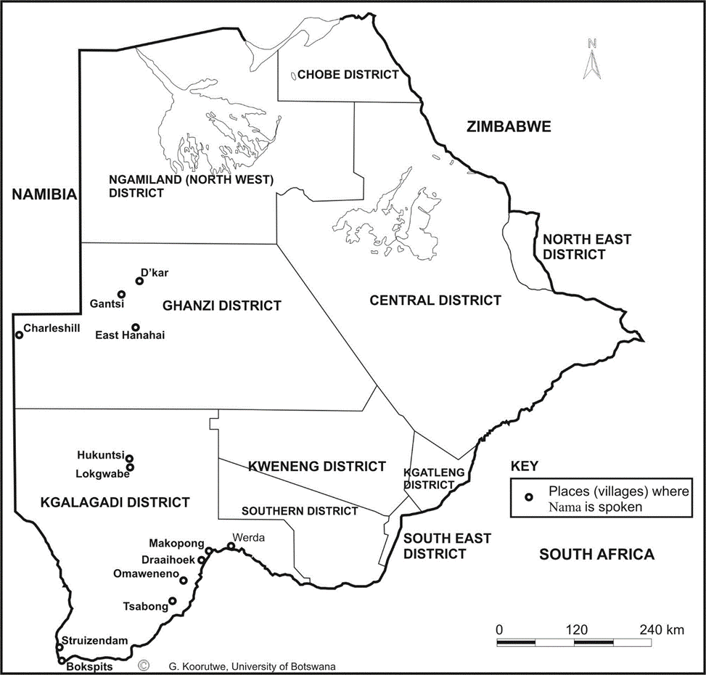
The spread of Nama in Botswana

Slide 12
Nama: Vibrancy among young learners
Whereas most of the indigenous Nama learners in Kgalagadi North can hear Nama, they speak and respond in Shekgalagari.
Some of the learners have shifted to and others are in the process of shifting from Nama to Shekgalagari.
Whereas Nama learners in Kgalagadi South can hear Nama, they speak and respond in the Setlharo dialect of Setswana. This shift was exacerbated by the school system that requested parents to speak to their children in Setswana in order to offset the tremendous language hurdle experienced in the classroom.

Slide 13
Nama: Vibrancy among young learners
Just like in Kgalagadi North, young Nama learners in Kgalagadi South have shifted or are in the process of shifting from Nama to Setswana (Setlharo).
The vibrancy of Nama among young learners in Ghanzi is precarious in that they speak various languages depending on their location. Those in Ghanzi township speak Shekgalagari, those in Charleshill area speak OtjiHerero, those in Hanahai areas speak Gǁana/Gǀui, and those in D’Kar region speak Naro.

Slide 14
Nama: Development
Department of Curriculum Development and Evaluation (DCDE) has been seized with the development of literacy materials for Nama as well as the other Phase 1 languages (State of the Nation Address 2022)
Nama has received substantial development generated from outside the country since it trans-borders into Namibia.
There is a preponderance of literature in Nama in Namibia, from pre-school to tertiary.

Slide 15
Nama: Development
A standard orthography
Several grammar books, a dictionary and glossary (W. Haacke)
School and church materials in Namibia.
Several cultural texts, reading materials and story books.
The language is used in the education system in Namibia
Most of the developments done in Namibia.
(Was discontinued in schools in Botswana in 1966)

Slide 16
Nama: Challenges
Classroom dynamics will be a challenge because possibly all young Nama learners do not speak Nama, but the policy seeks to introduce education to learners in the mother tongue.
Nama is spoken by a demographically minute speech community, raising the question of sustainability.
In addition to Setswana, Shekgalagari, OtjiHerero and Naro which some of the young Nama learners speak are part of the 13 languages to be introduced in Phase 1.

Slide 17
Naro: Language spread and demographics
Naro is found in the Ghanzi and Ngamiland.
Estimations from the 2022 census in Botswana puts Naro speakers 18 000 to 25 000.
It is considered one of the major Khoesan languages in Botswana, constituting approximately 10% of the language cluster.

Slide 18
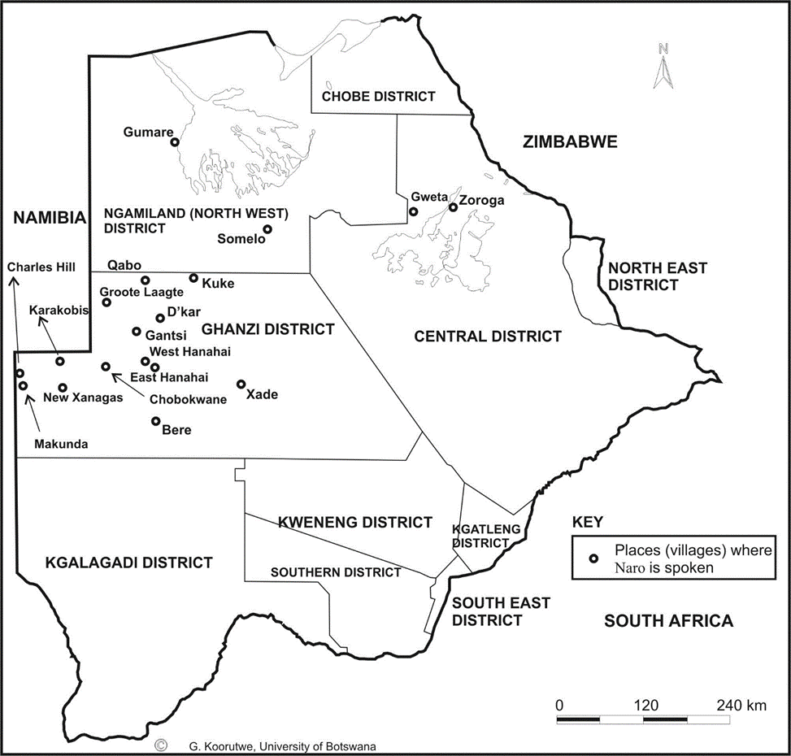
Naro: Language spread

Slide 19
Naro: Vibrancy among young learners
There is no trans-generational dislocation in the transition of the language to younger generations.
Young learners speak Naro as their first language with full
competence.

Slide 20
Naro: Development
A standard orthography
Grammar book (Rev H. Visser)
A Naro-English dictionary (1997) (Rev. H. Visser)
Several scientific descriptions of the language done
Several texts and church materials
Several literacy materials usable also for primary school
Several cultural texts and story books.
The whole Bible has been translated in Naro.
Most speakers and most developments in Botswana.

Slide 21
Naro: Development
Through the auspices of the Dutch Reformed Church, (Hessel and Coby Visser) Naro has received extensive development.
One of the most notable development is the translation of the Old and New testaments into the language.
Department of Curriculum Development and Evaluation (DCDE) has been seized with the development of literacy materials for Naro as well as the other Phase 1 languages (State of the Nation Address 2022)
Naro was one of the languages used in schools before the country gained independence.

Slide 22
Naro: Challenges
Classroom dynamics should not encounter many challenges because Naro young learners speak the language, a considerable number of which is literate in the language.
Considering that it is one of the major Khoesan languages in Botswana, constituting approximately 10% of the language cluster, sustainability should not be a major problem.

Slide 23
Khwedam: Spread and demographics
The four languages of the Okavango that constitute Khwedam Aǁnikwe, Bugakwe, |Anda and Khwe are spoken in the North-west District of Botswana.
Estimate number of speakers = 2000 to 4000

Slide 24
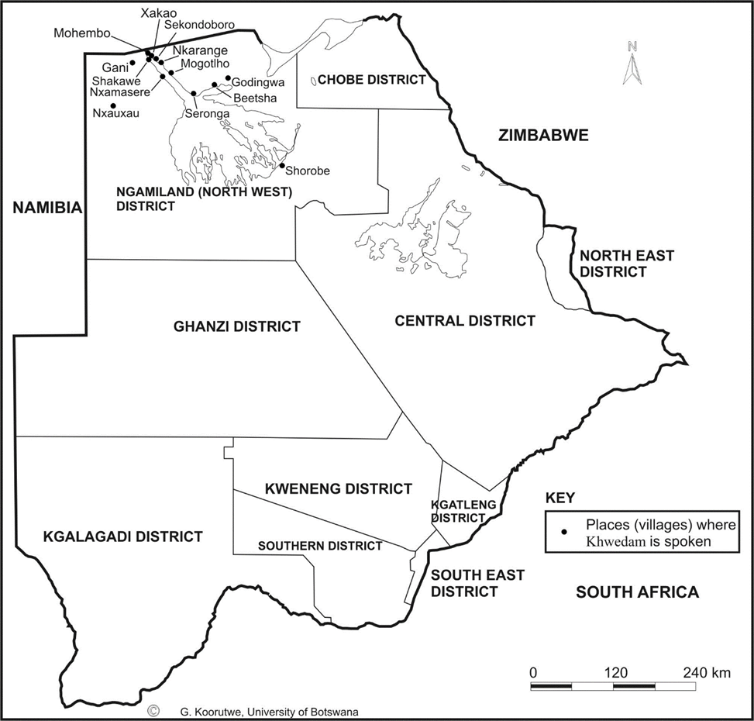
Khwedam: Spread and demographics

Slide 25
Khwedam: Development
A standard orthography (by Brezinger & Schaldt)
Several descriptions of the language including a dictionary, plant lists, lists of place name, regional map.
Khoe language committee has been working on a lexicon
Several church materials
Several cultural descriptions by Oswin Kohler.
Oral history book by community members (translated in English)
No literacy materials/pedagogical materials

Slide 26
Khwedam: Development
No literacy materials/pedagogical materials
Department of Curriculum Development and Evaluation (DCDE) has been seized with the development of literacy materials for Khwedam as well as the other Phase 1 languages (State of the Nation Address 2022)

Slide 27
Khwedam: Challenges
Classroom dynamics will be a challenge because most Khwedam learners do not speak the language, but the policy seeks to introduce education to learners in the mother tongue.
They have shifter to Thibukushu
The numbers are considerably low.
.

Slide 28
San languages: Level of Development
Notes:
Ju is the most developed of the San languages spoken in Botswana.
This is a cross border language with Namibia and most of the language development was done in Namibia.

Slide 29
Conclusion:
Nama:
Learners do not speak Nama, and in the proposed localities for introduction of Nama learners speak either Shekgalagari or Setlharo.
Mother-tongue teachers in Botswana might prove a challenge to find.
For language preservation, proficiency classes might be suggested.

Slide 30
Conclusion:
Naro:
Naro learners speak the language.
Mother-tongue teachers in Botswana should not be a challenge to find.
Speakers are literate in the language because of missionary work/ literacy materials
Was used as a medium of instruction before independence
Chances of success are reasonably high.

Slide 31
Reflections:
Khwedam:
Khwedam languages face the risk of being absorbed or assimilated into larger, dominant languages.
They are also spoken by demographically minute speech communities.
Mother-tongue teachers in Botswana might be a challenge to find.

Slide 32
The End
Thank You!

